Slide 1
FaceSense AI-An AI Driven Real-Time Video Interview System With Sentiment Analysis
PROJECT STAGE-I REVIEW
24-11-2025
Under the Guidance
Presentation by
Mrs. D.GANGA RANI
Mr. SHAIK SAMEER (22C11A05C8)
Assistant Professor,
Department of CSE
Mr. EERLA NAGARAJU (22C11A0581)
Department of Computer Science and Engineering

Slide 2
Contents
Introduction
Abstract
Base Paper
Literature Review
Existing Project
Drawbacks
Problem Statement
Proposed System
Objectives
Architecture
Software and Hardware Requirements

Slide 3
Modules
Design Diagrams
References

Slide 4
Introduction
Video interviews have become an integral part of modern recruitment processes as organizations increasingly adopt digital hiring solutions. Traditional interviews lack automation in evaluating the candidate's emotional state, facial expressions, and behavioral cues. Leveraging Artificial Intelligence, this project aims to build a real-time video interview system integrated with sentiment analysis to assist recruiters in making data-driven hiring decisions.

Slide 5
Abstract
With the shift towards virtual recruitment, traditional interview systems often fail to capture non-verbal cues and real-time emotional states of candidates. FaceSense AI addresses this gap by providing an AI-powered video interview platform that integrates real-time facial emotion recognition, sentiment analysis, and automated feedback. The system simulates a realistic interview environment where an AI interviewer dynamically generates questions, transcribes responses using Whisper AI, and analyzes emotions through DeepFace. The backend, built in Python, handles AI processing, while a React-based frontend delivers an interactive user interface. Key features include candidate authentication, real-time emotion tracking, sentiment scoring, and automated performance reports with actionable suggestions. The platform is designed for scalability, making it suitable for HR teams, recruitment agencies, and career guidance platforms. By offering unbiased, data-driven assessments, FaceSense AI not only streamlines the hiring process but also empowers job seekers to enhance their performance, making it valuable for both industry and societal skill development initiatives.

Slide 6
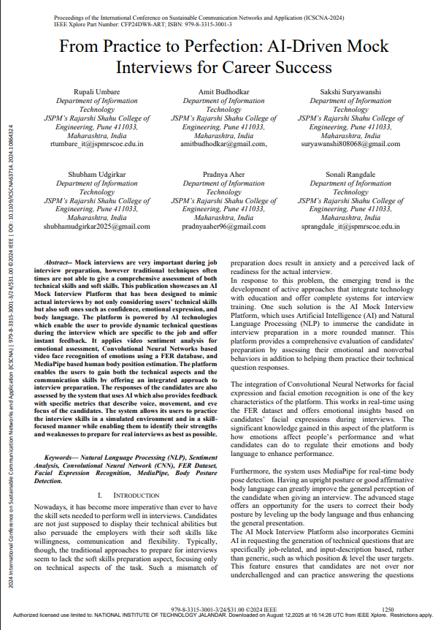
Base Paper

Slide 7
Literature Review
Paper 1: “Deep Learning-Based Human Emotion Recognition from Facial Expressions”
Authors: S. Li et al., IEEE Access, 2019
About the Paper:
Introduces convolutional neural networks for automatic facial emotion recognition. The work demonstrates how CNNs capture micro-expressions and subtle cues from video frames, forming the basis for real-time emotion detection in modern AI systems like FaceSense AI.
Paper 2: “Real-Time Speech Emotion Recognition Using Deep Recurrent Neural Networks”
Authors: M. Neumann and N. Vu, ICASSP 2020
About the Paper:
Proposes a recurrent neural-network-based framework for analyzing emotional tone in voice recordings. It highlights how integrating acoustic and linguistic cues enhances interview-style sentiment assessment.

Slide 8
Literature Review(contd…)
Paper 3: “Multimodal Sentiment Analysis Combining Facial Expressions and Speech”
Authors: P. Tzirakis et al., IEEE Transactions on Affective Computing, 2021
About the Paper:
Explores fusion of visual and audio modalities for better sentiment prediction. The study shows that merging face and voice features improves emotion-recognition accuracy—an approach directly used in FaceSense AI’s multimodal feedback.
Paper 4: “Automated Behavioral Analysis for Virtual Job Interviews Using AI”
Authors: A. Gupta and K. Sharma, International Journal of AI Research, 2022
About the Paper:
Develops an AI framework that analyzes facial expressions and voice tone to assess candidate performance. The methodology inspires FaceSense AI’s mock-interview and evaluation structure.

Slide 9
Literature Review(contd…)
Paper 5: “Whisper: Robust Speech Recognition via Large-Scale Weak Supervision”
Authors: A. Radford et al., OpenAI Research, 2022
About the Paper:
Introduces Whisper, a multilingual speech-to-text model trained on large audio datasets. Its robustness to noise and accents underpins FaceSense AI’s accurate real-time transcription of candidate responses.

Slide 10
Existing Project
Existing platforms like Zoom and Microsoft Teams provide video-based interviews and basic candidate evaluation features.
Some tools incorporate automated assessments, but they often lack real-time sentiment and facial expression analysis, limiting the depth of evaluation.
Most existing systems focus on video recording and question delivery rather than intelligent interpretation of candidate emotions and communication styles.

Slide 11
Drawbacks
No sentiment or tone analysis
Requires manual review by recruiters
High chances of human bias
Cannot auto-generate or adapt interview questions
No behavioral or confidence evaluation
Only records video, does not interpret it

Slide 12
Problem Statement
The traditional video interview systems do not support automated real-time sentiment analysis and behavior interpretation, which makes the recruitment process time-consuming, less objective, and prone to bias. There is a need for a solution that not only facilitates video interviews but also provides instant insights about candidates’ emotions, confidence level, and engagement.

Slide 13
Proposed System
The proposed system is an AI-driven real-time video interview platform integrated with machine learning algorithms for sentiment analysis.
The system will use computer vision to analyze facial expressions, body language, and emotions, as well as natural language processing (NLP) to evaluate tone, mood, and communication effectiveness.
The output will provide both recruiters and candidates with real-time feedback and comprehensive reports, enabling efficient, unbiased, and intelligent decision-making in candidate evaluation.

Slide 14
Objectives
To develop a real-time video interview system that integrates AI and sentiment analysis.
To analyze facial expressions, emotions, and tone of voice during interviews.
To reduce hiring biases and provide recruiters with data-driven insights.
To save time and cost by automating initial candidate evaluation.
To enhance user experience with a reliable, secure, and scalable platform.

Slide 15
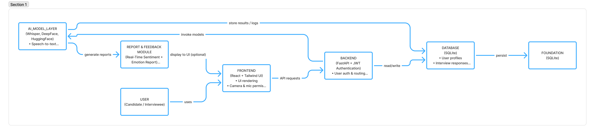
Architecture

Slide 16
Software and Hardware Requirements
Software Requirements:
Programming Languages: Python, JavaScript
Frameworks: TensorFlow / PyTorch (for AI models), OpenCV (for facial analysis), Flask (backend), ReactJS/Angular (frontend)
Databases: My SQL
APIs: Google Vision API, Speech-to-Text APIs, Sentiment Analysis Libraries (NLTK/TextBlob)
Operating System: Windows
IDE: Visual Studio Code
Hardware Requirements:
Processor: Intel i5 core 5
RAM: Minimum 8 GB (16 GB recommended)
Hard Disk: Minimum 500 GB
Webcam: HD Camera with microphone
Internet: Stable broadband connection

Slide 17
Modules
FaceSense AI is structured into several interconnected modules that manage authentication, AI-based processing, and performance analysis.
Each module handles a specific task to ensure modularity, scalability, and accuracy in real-time interview evaluation.
Main Functional Modules:
Authentication & User Management : Secure login/signup with JWT and encrypted passwords stored in SQLite.
Question Generation : Uses Hugging Face LLM to create dynamic and topic-based interview questions.
Audio & Speech Processing : Captures voice input and converts it to text using Whisper for accurate transcription.

Slide 18
Modules(contd…)
Sentiment Analysis : Evaluates tone and confidence from transcribed speech using Hugging Face sentiment pipeline.
Emotion Detection : Uses DeepFace to analyze real-time facial emotions such as happy, neutral, or sad.
Real-Time Feedback : Combines sentiment + emotion data to display live confidence and engagement insights.
Report Generation : Creates downloadable PDF reports summarizing overall performance, sentiment trends, and emotional responses.

Slide 19
Modules(contd…)
Frontend UI : Built with React + Tailwind CSS for responsive design; includes login, live interview, and report dashboards.
Logging & Monitoring : Tracks session data, API activity, and performance logs for continuous optimization.

Slide 20
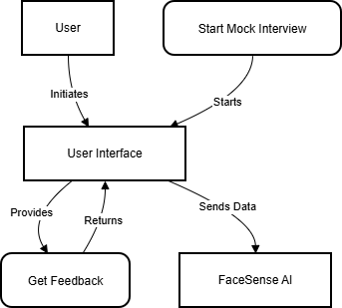
Design Diagrams
Use case Diagram

Slide 21
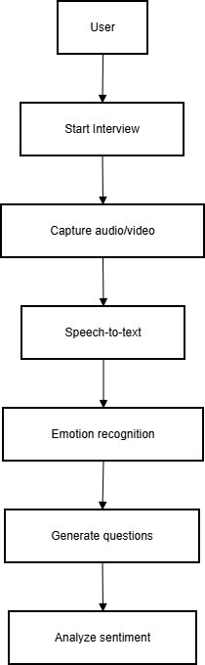
Activity Diagram

Slide 22
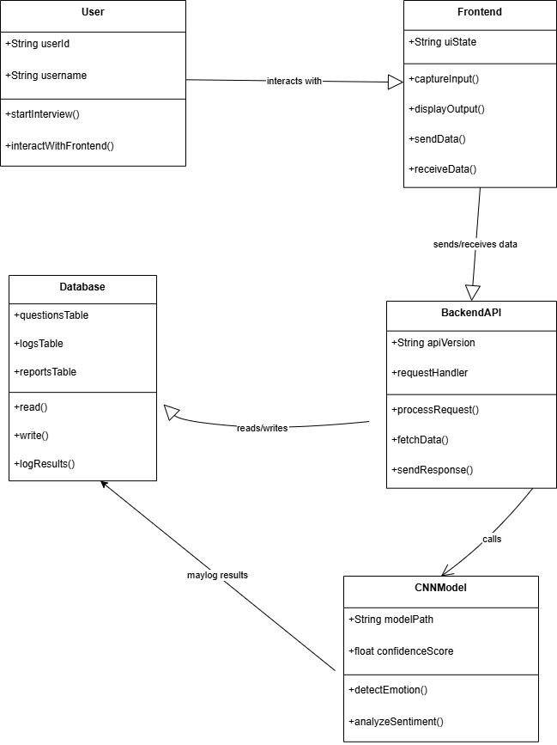
Class Diagram

Slide 23
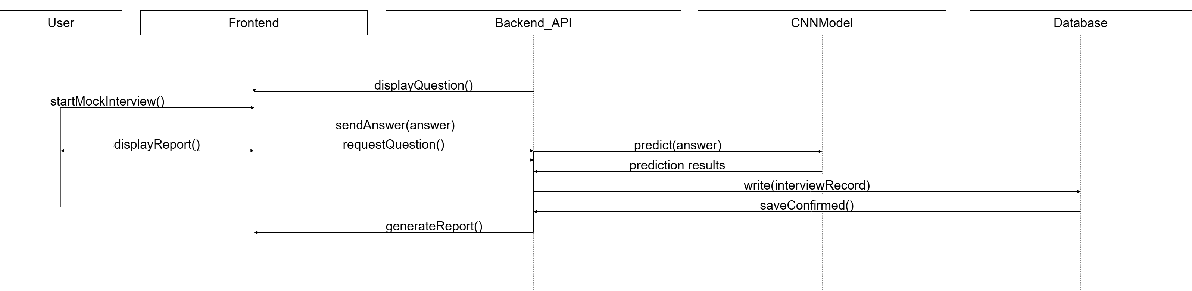
Sequence Diagram

Slide 24
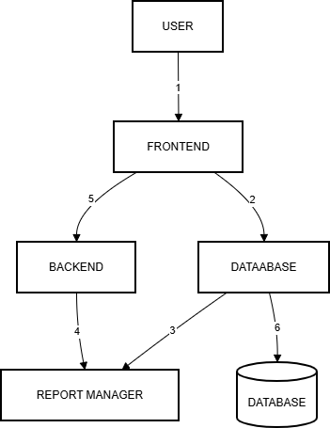
Collaboration Diagram

Slide 25
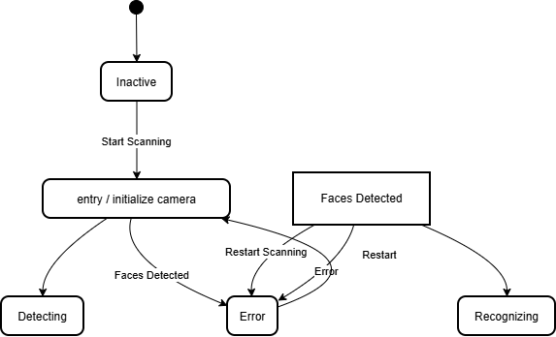
State Diagram

Slide 26
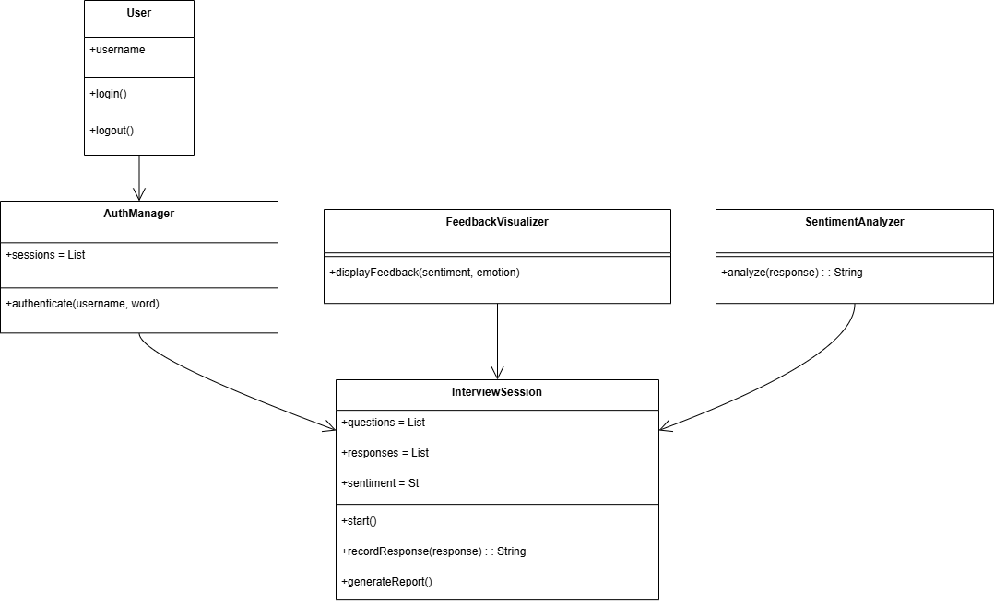
Refined Class Diagram

Slide 27
References
Jurafsky, D., & Martin, J.H. (2021). Speech and Language Processing (3rd Edition).
OpenCV Documentation: https://docs.opencv.org
TensorFlow Documentation: https://www.tensorflow.org
IEEE Journals on AI-driven Sentiment Analysis and Video Interview Systems.
Research papers on emotion recognition and automated recruitment tools (IEEE Xplore).

Slide 28
TEST CASES
TC ID | Module | Test Case Description | Expected Result | Status
TC-01 | Auth | Login with valid credentials | User redirected to dashboard | Pass
TC-02 | Auth | Login with invalid credentials | Error message shown | Pass
TC-03 | Dashboard | Start HR interview | HR interview page loads | Pass
TC-04 | Dashboard | Start technical interview | Interview starts with selected tech | Pass
TC-05 | Interview | Load interview questions | Questions displayed sequentially | Pass
TC-06 | Speech | Start/Stop microphone | Speech converted to text | Pass
TC-07 | Camera | Enable webcam | Live video feed visible | Pass

Slide 29
TEST CASES
TC ID | Module | Test Case Description | Expected Result | Status
TC-08 | Emotion | Face emotion detection | Emotion detected in real-time | Pass
TC-09 | AI Analysis | Emotion → confidence mapping | Confidence score updated | Pass
TC-10 | Timer | Interview timer expiry | Interview auto-ends | Pass
TC-11 | Submission | Submit answer | Submission recorded | Pass
TC-12 | Feedback | Generate interview summary | AI feedback displayed | Pass
TC-13 | Report | Download PDF report | PDF downloaded successfully | Pass
TC-14 | Profile | Edit name/email/photo | Profile updated | Pass

Slide 30
OUTPUT

Slide 31
OUTPUT

Slide 32
OUTPUT

Slide 33
OUTPUT

Slide 34


